Slide 1

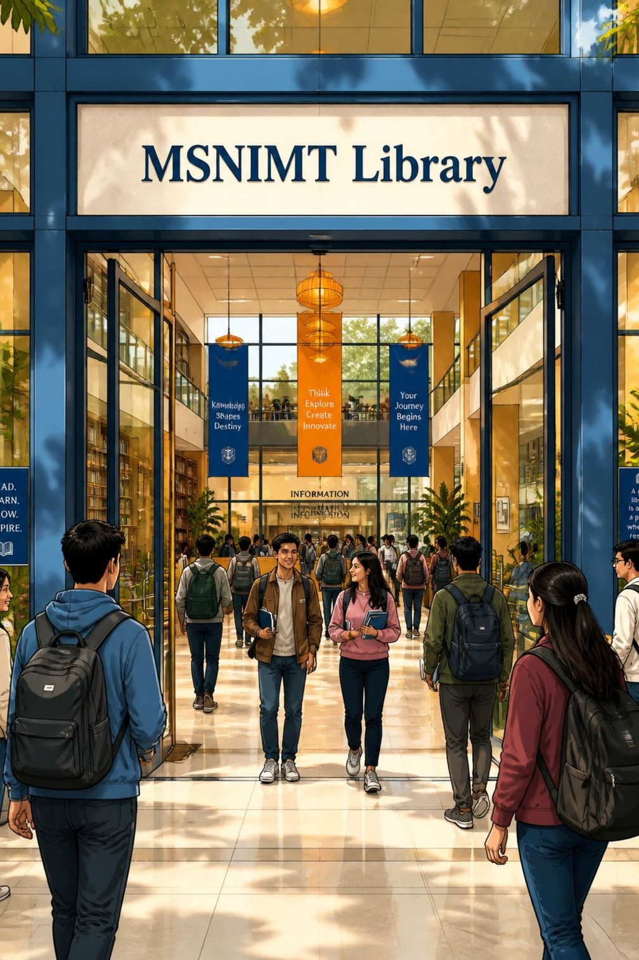
MSNIMT Library
Library & Information Centre — a modern academic hub supporting teaching, learning and research for students and faculty at MSNIMT.
Notes:
1

Slide 2
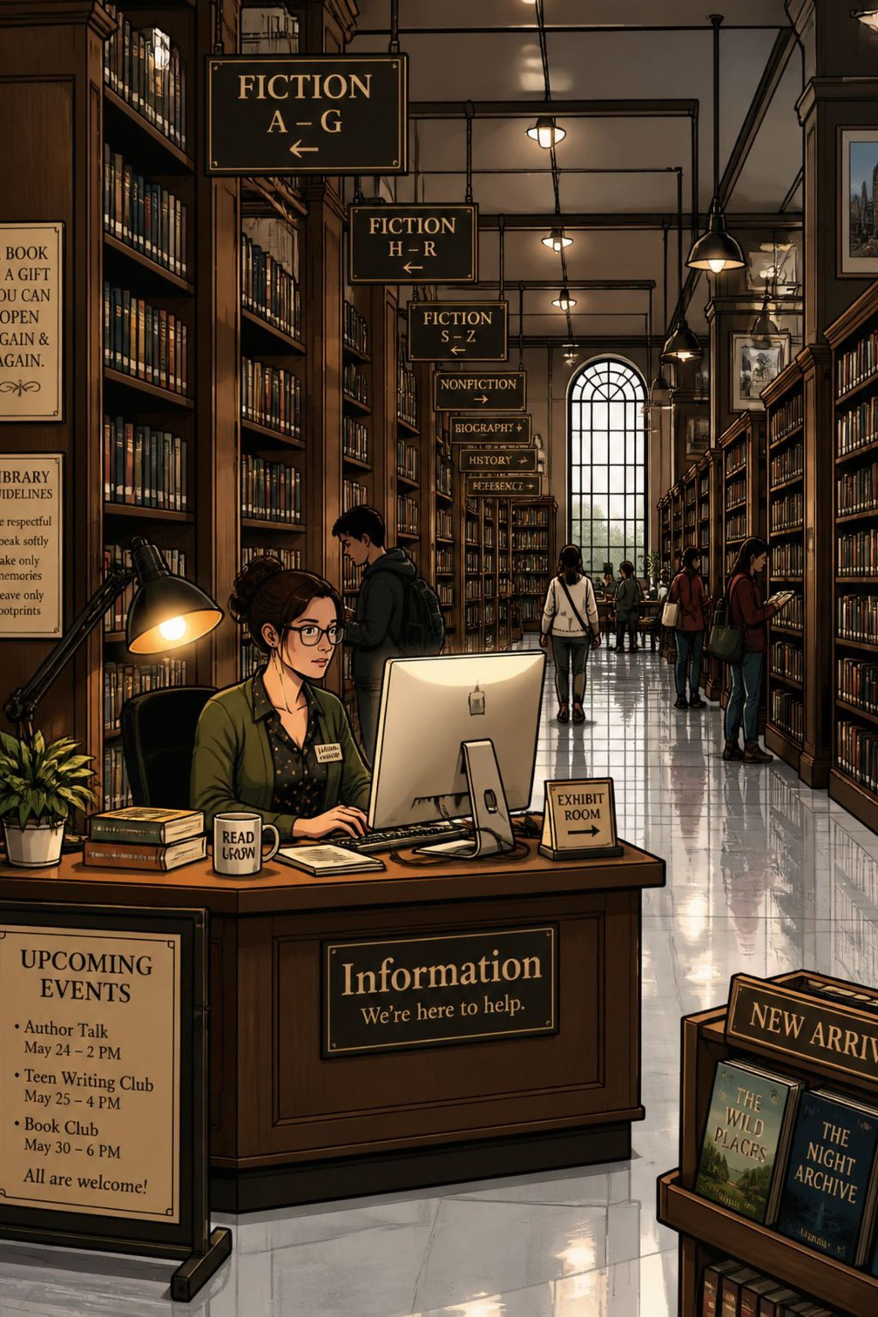

About the Library
Established
Automation
MSNIMT Library & Information Centre, founded in 2002, serves the campus community with curated academic resources.
Fully automated using LIBSOFT — integrated cataloguing, circulation and inventory management.
Classification
Website
Uses the Dewey Decimal Classification (DDC) scheme for consistent subject organization.
Visit the library portal for services and catalog access: wwwmsnimtlibrary.org
Notes:
2

Slide 3
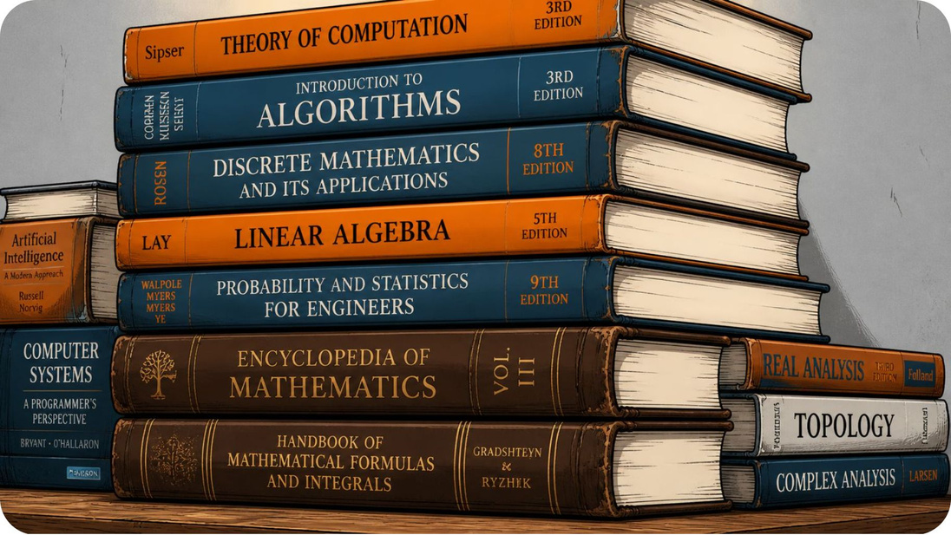

Library Resources
Comprehensive collection supporting coursework and research:
  Books: Textbooks & reference works (over 8,000 volumes; 4,400+ unique titles)
  Periodicals: Academic journals, magazines and newspapers (40+ subscriptions)
  Digital media: CD/DVDs, and e-learning materials
Collection numbers are regularly updated — check the online catalog for current availability.
Notes:
3

Slide 4









Library Sections & Areas
Purpose-designed spaces to support study, access and services:
Gate Entry
Librarian Cabin
Circulation Section
Magazine / Periodical Section
Entry control and visitor register ensure security and record-keeping.
Staff work area for administration and user assistance.
Book lending, returns, fines and user enquiries.
Current and bound journals, trade and academic magazines, newspapers.
Reference Section
Stack Area
Technical Processing
E-learning Area
Consultation-only resources: encyclopedias, dictionaries, yearbooks.
Main book collection arranged by department and DDC classes.
Cataloguing, classification, accessioning and barcode preparation.
Computers and digital resources for online courses and multimedia study.
Reprography / Photocopy
Document duplication services for users, subject to copyright rules.
Notes:
4

Slide 5
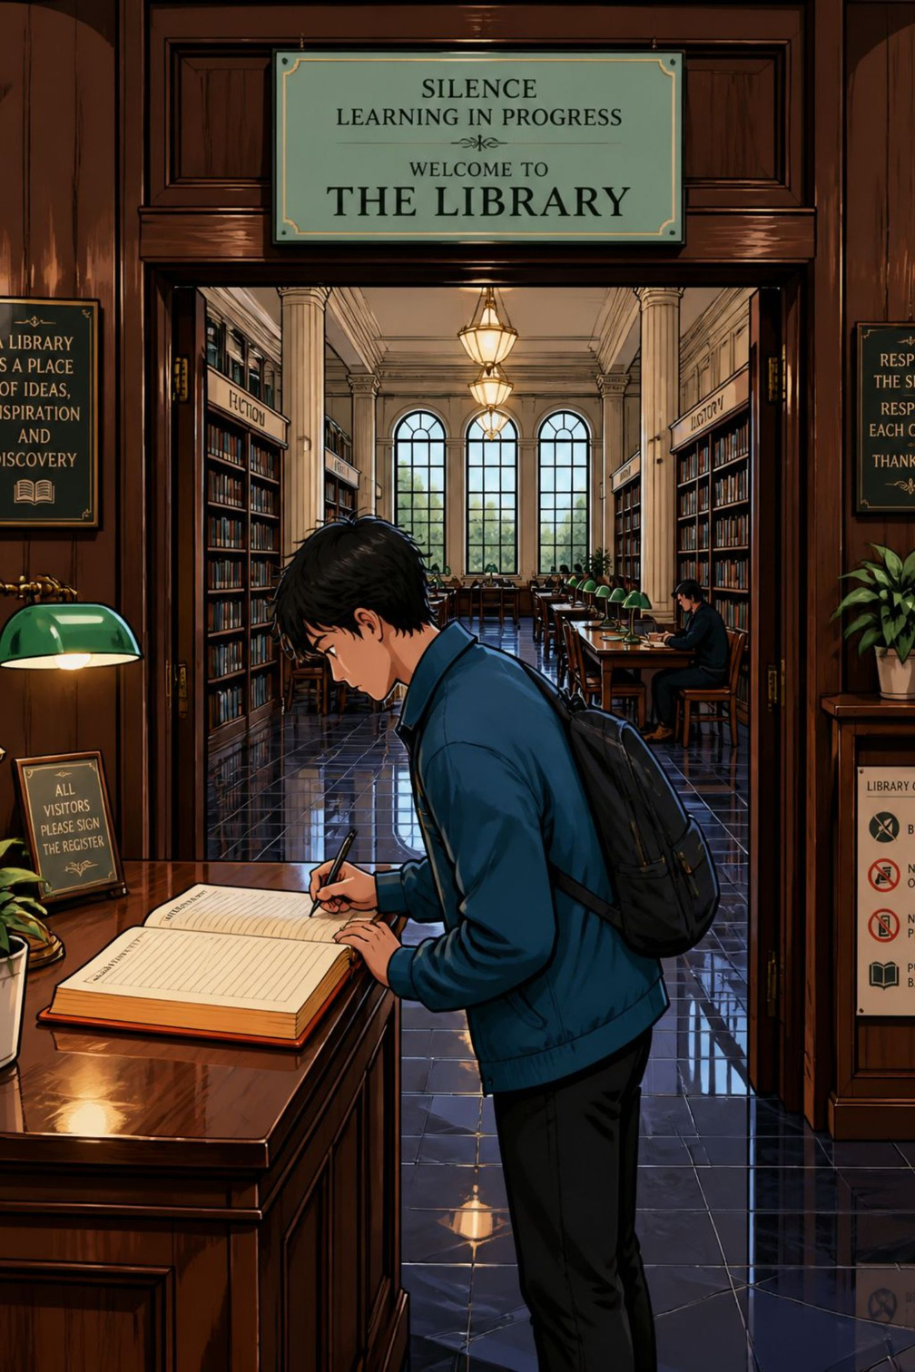
Gateway Area — Rules & Procedure
First point of contact: registration and basic conduct expectations.
Sign-in Requirement
Register Availability
Property Storage
Designated property areas are available for bags and belongings; valuables should not be left unattended.
All users must record their entry in the gateway register before using the library.
Separate registers provided for Students and Faculty at the circulation entry.
Mobile Phones & Conduct
Mobile phones are strictly prohibited inside. Maintain strict silence and discipline to preserve a study-friendly atmosphere.
Notes:
5

Slide 6
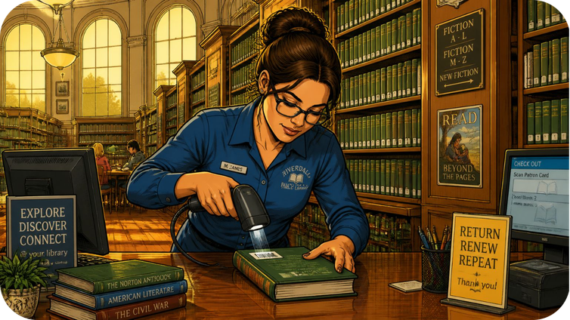

Circulation Section — Services
Core operations that keep resources flowing to users:
  Lending books to registered users with issue/return procedures
  Check-in for returned items and condition assessments
  Fines and receipts: charging for overdue items and maintaining records
  Monitoring and reporting damaged or lost materials
For lending periods, renewals and fines, consult the LIBSOFT portal or circulation desk.
Notes:
6

Slide 7
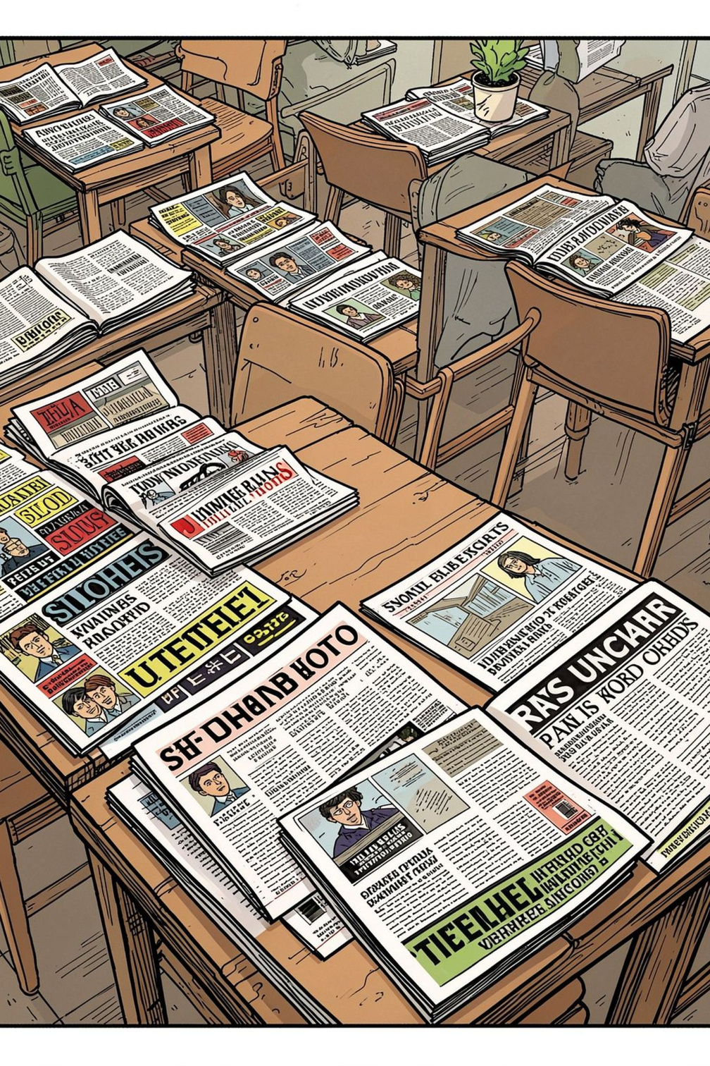



Periodical Section
Accessible, current content for research and staying informed.
Newspapers
Daily Malayalam and English newspapers available for on-site reading.
Academic Journals
More than 40 subscriptions covering core academic and professional subjects.
Magazines
Career-oriented and subject-specific magazines to support placements and current-awareness.
Notes:
7

Slide 8
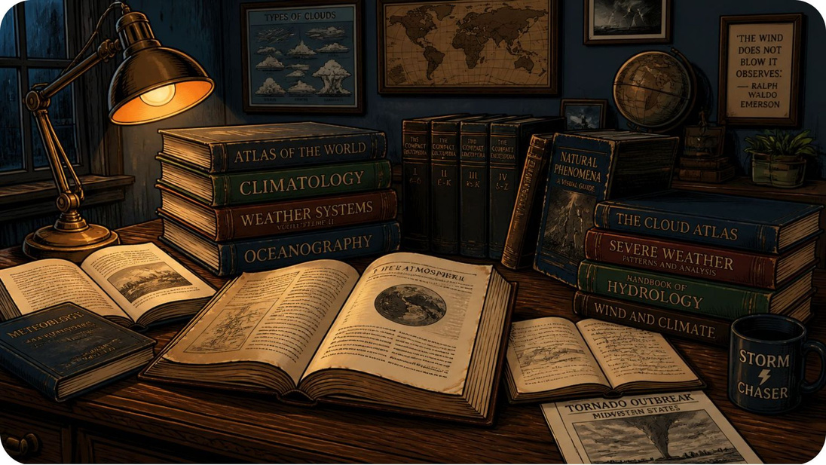
Reference Section — In-Library Use
Materials in this section are for consultation within the library only. Typical holdings include:
  Encyclopedias and Handbooks
  Language and Subject Dictionaries
  Year books, directories and statistical compilations
  Special volumes and rare reference compilations
Reference works are non-circulating to ensure availability for all users.
Notes:
8

Slide 9
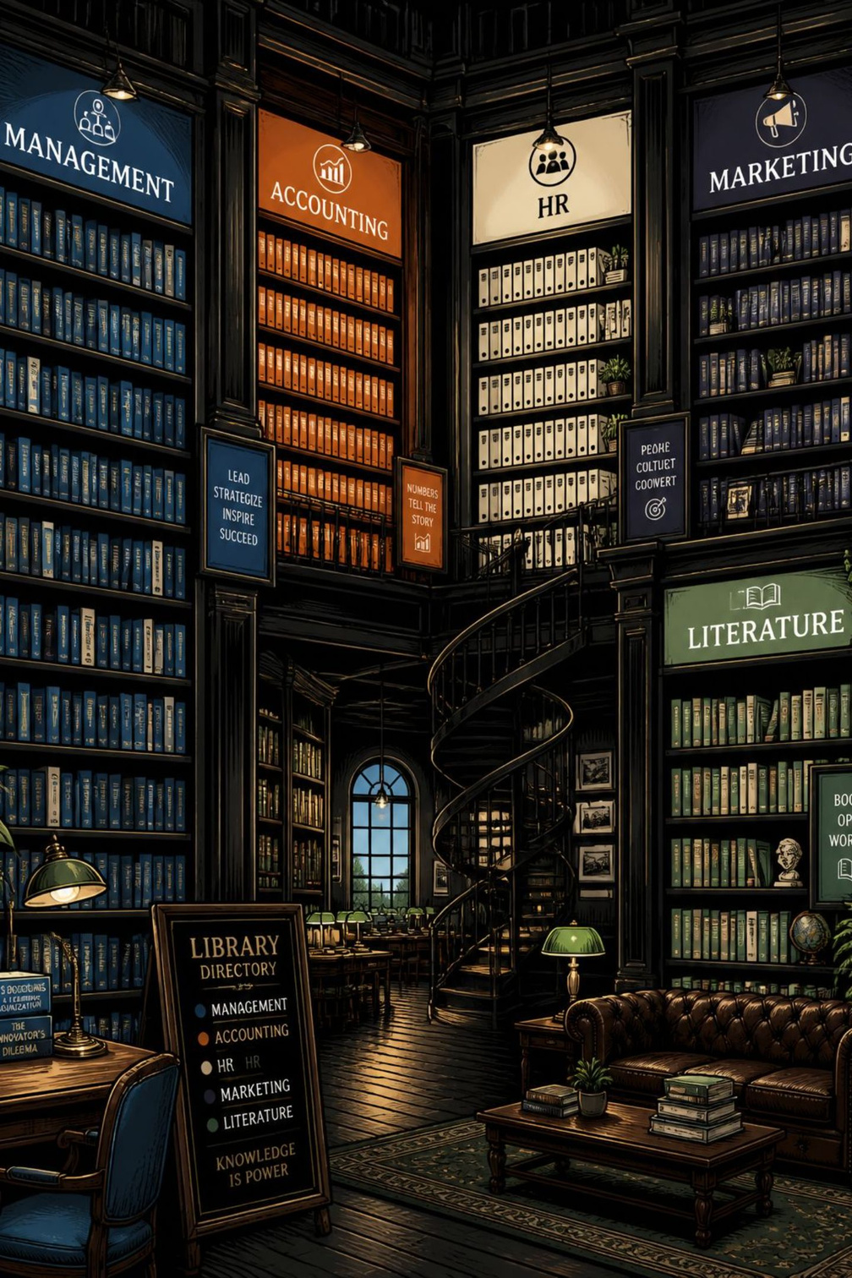
Stack Room — Department Collections
The Stack Room houses the bulk of the library collection, organised by subject and department:
Business & Management
Language & Literature
Management, Financial Management, Accounting, Human Resource, Marketing collections grouped for easy access.
Extensive English and Malayalam literature holdings including fiction, criticism and study guides.
Biographies & Miscellaneous
Biographies, autobiographies and specialized subject volumes support contextual and historical study.
Notes:
9

Slide 10
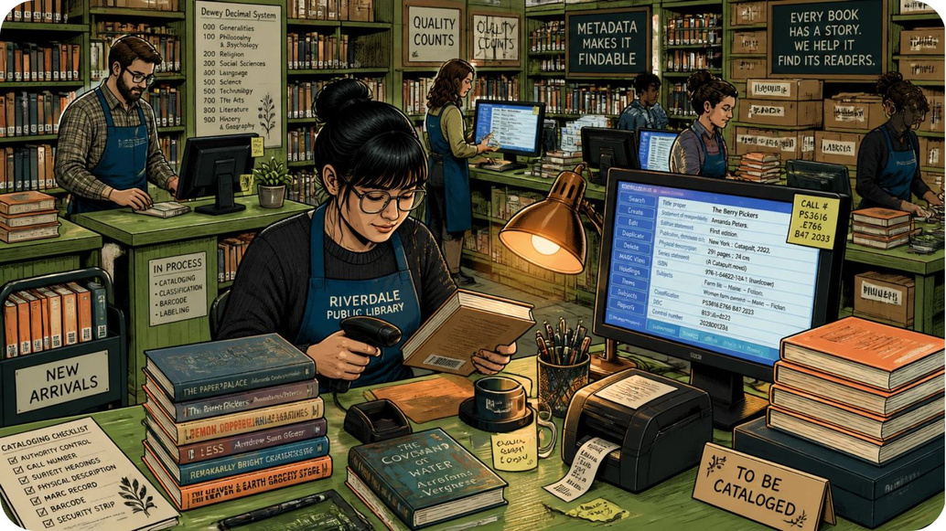

Technical Processing Section
Behind-the-scenes workflows that make the collection discoverable and usable:
  Processing of new acquisitions: accessioning and physical preparation
  Classification using the DDC scheme for consistent shelving and retrieval
  Cataloguing and metadata entry performed in LIBSOFT, with barcodes generated for circulation
  Regular maintenance: binding, repairs and inventory audits
Accurate technical processing ensures quick discovery via the online public access catalog (OPAC).
Notes:
10

Slide 11
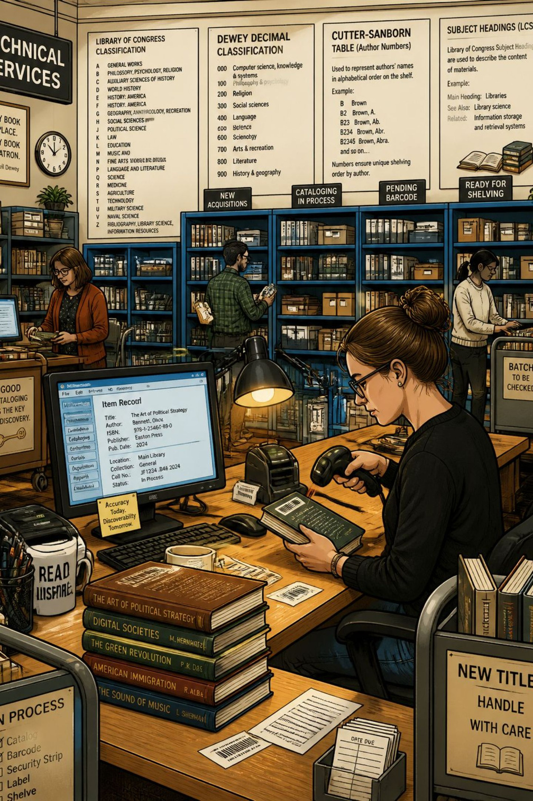
Technical Processing — Book Intake & Classification
The Technical Processing Section handles incoming books: accessioning, classification, cataloguing, and barcode preparation. We use the Dewey Decimal Classification (DDC) scheme to maintain consistent subject organization and discoverability.
Key Systems
Core Tasks
LIBSOFT library automation software manages cataloguing, classification fields, and barcode generation.
Physical inspection, DDC assignment, MARC record creation, labeling, and barcode printing.

Slide 12
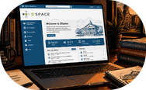


E‑Learning Area — Digital Access & Portals
The E‑Learning Area gives campus users streamlined access to high-value electronic resources. Desks and terminals are configured for research, online courses, and institutional repositories.
DSpace
Open Courseware
DELNET
Institutional repository for theses, reports, and open-access materials hosted locally.
Portals such as NPTEL, SWAYAM, and e-PG Pathshala support curriculum-aligned online learning.
Subscription-based resource sharing: interlibrary loans, e-journals, and e-books across a national network.

Slide 13
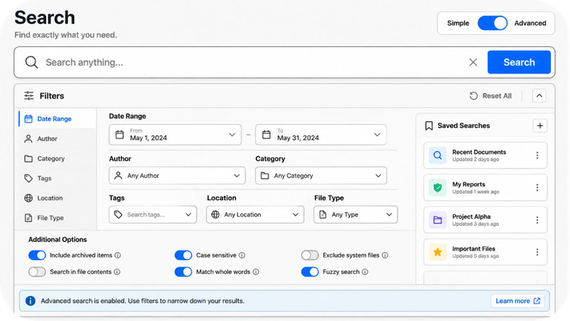
OPAC — Online Public Access Catalogue
OPAC enables users to discover library holdings, check availability, and locate items on the shelves. Accessible at www.msnimt.libsoft.org.
Search Modes
  Quick Search — keyword-based, fast results
  Simple Search — additional fields for author/title refinement
  Advanced Search — multi-field queries, Boolean operators, date and subject filters
Search tips: use keywords, synonyms, and filters to narrow results; advanced search surfaces precise matches.

Slide 14
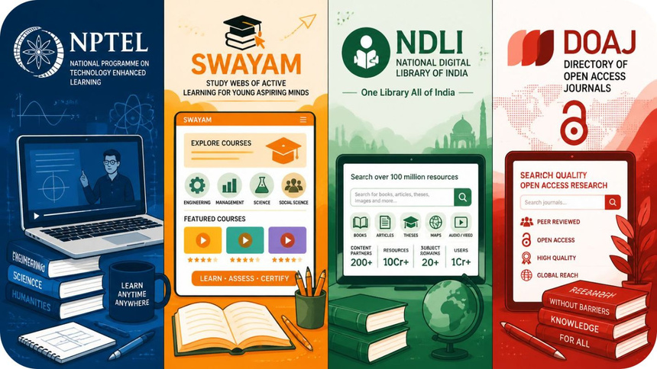
Library Website — Curated Resource Links
The library website centralizes access to authoritative learning platforms, databases, and institutional services. It also links to OPAC and DSpace.
Primary links provided:
  DELNET
  NPTEL & Courses
  e-PG Pathshala
  Shodhganga
  OPAC
  DSpace

Slide 15
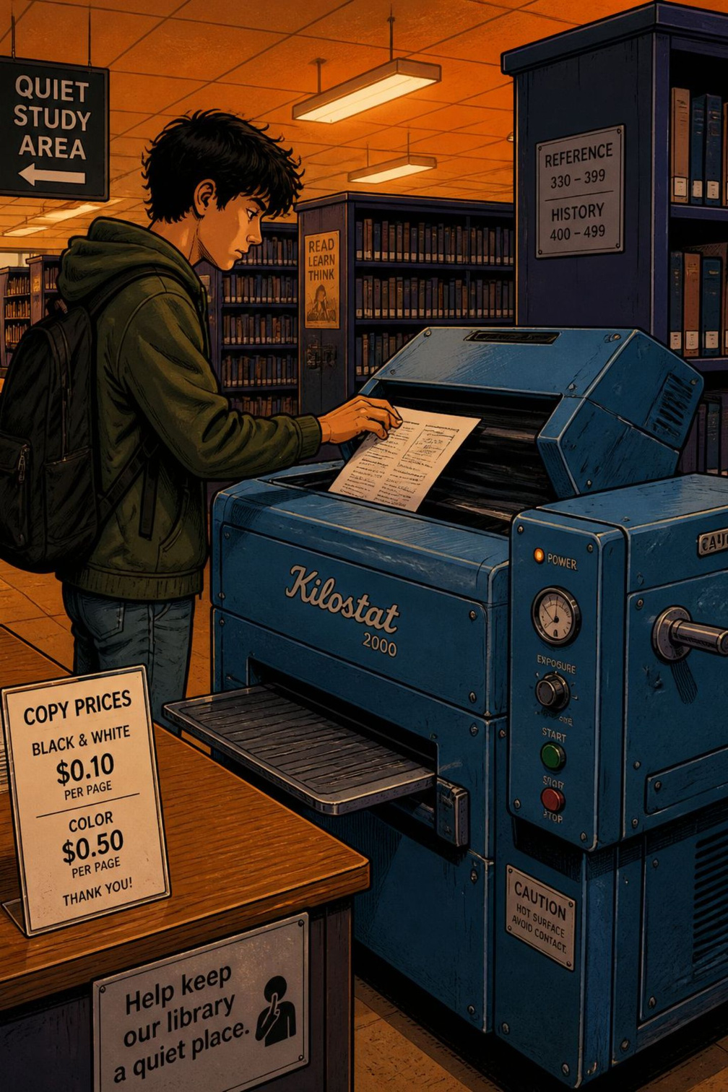
Reprographic Services — Photocopying
Reprography is available on request. Users may photocopy pages from library materials; standard charge is INR 1 per A4 page. Payment and service hours align with circulation desk operations.
How to Use
Copyright Notice
Bring the material to the reprographic counter; staff will assist with copying and payment processing.
Respect copyright: only permissible portions of copyrighted works may be copied per national law and library policy.

Slide 16
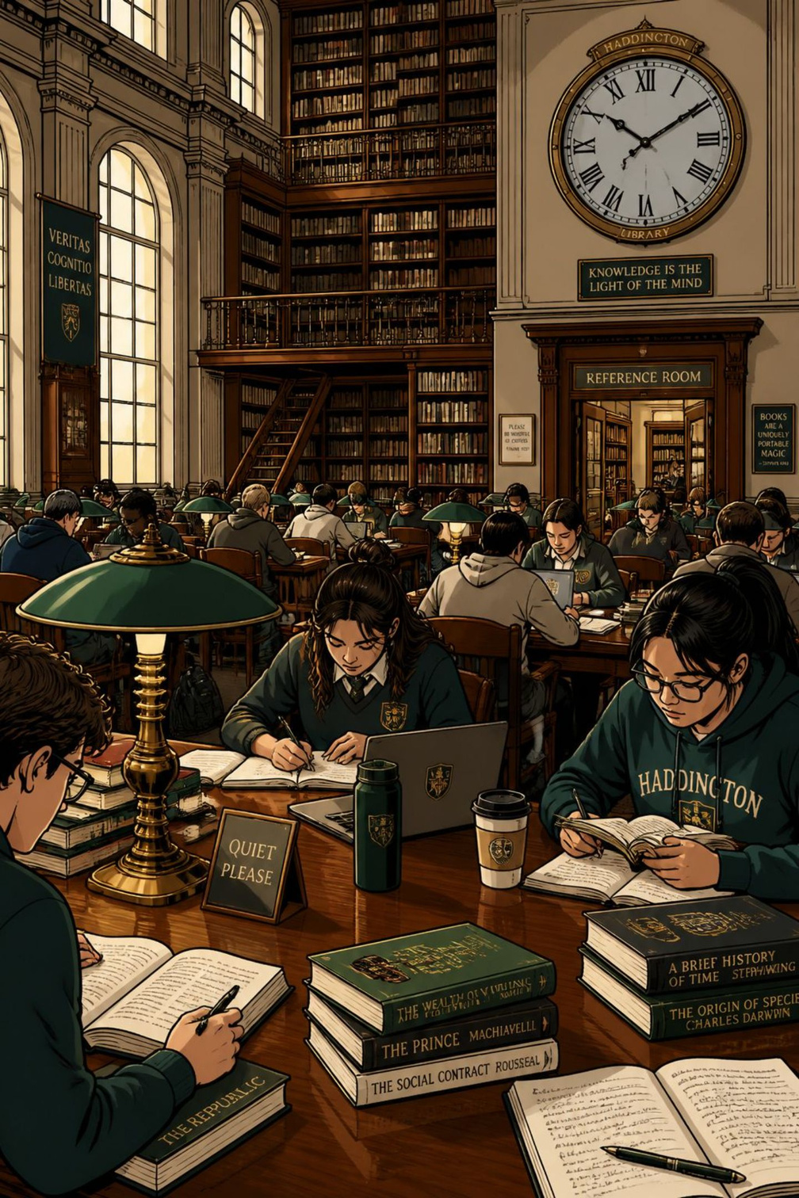
Library Hours — When We're Open
Regular opening times are posted to help students and staff plan visits. Exceptions (holidays, events) are announced on the website and notice boards.
Weekdays
Monday–Friday: 9:30 AM — 4:30 PM
Saturday
9:30 AM — 4:00 PM
Closures
Closed on Sundays and public holidays

Slide 17
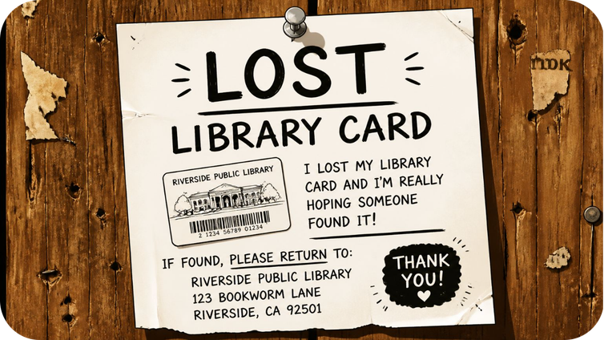
Membership Card — Identity & Access
Membership cards are issued with barcodes for circulation and identification. Students must complete the registration form available at the library counter.
Lost Card Procedure
If a card is lost, inform the librarian immediately to deactivate the barcode and request a replacement form. The card functions as the student's library ID.
  Collect form at circulation desk
  Provide ID proof for replacement

Slide 18
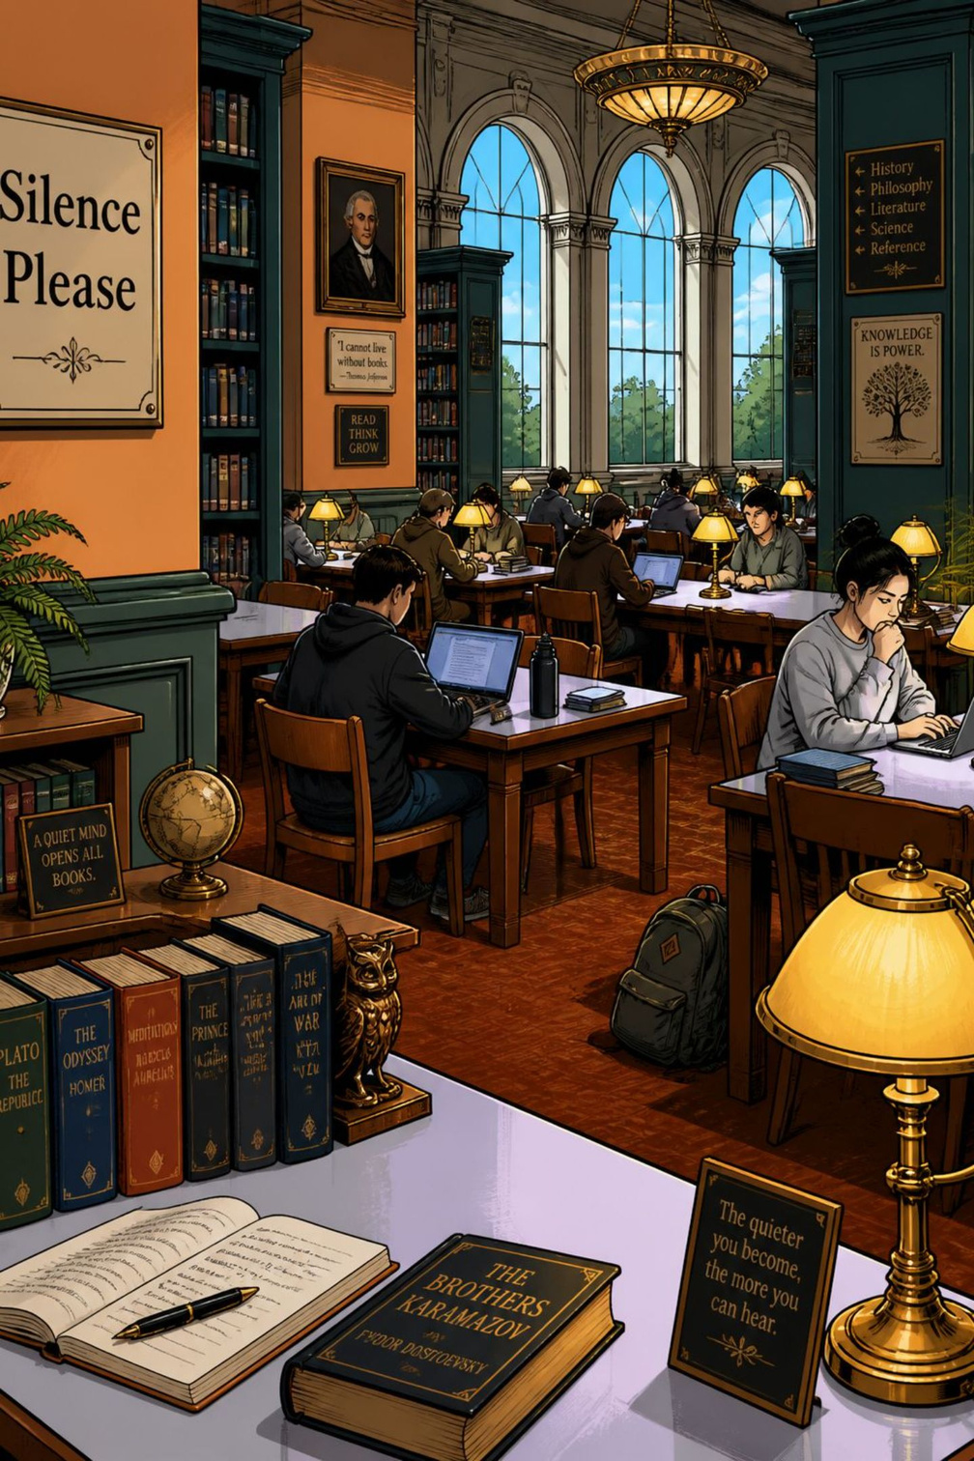




Basic Rules — Conduct & Care
Rules preserve a productive environment and protect resources. Compliance ensures fair access and longevity of materials.
Observe Silence
Enter quietly; maintain a low voice to respect other users.
Handle Materials Carefully
Do not damage books; report any defects to staff before borrowing.
No Mobile Phones
Mobile use is prohibited in reading areas—use designated zones if available.
Follow Library Rules
Adhere to borrowing limits, due dates, and staff instructions to avoid penalties.

Slide 19
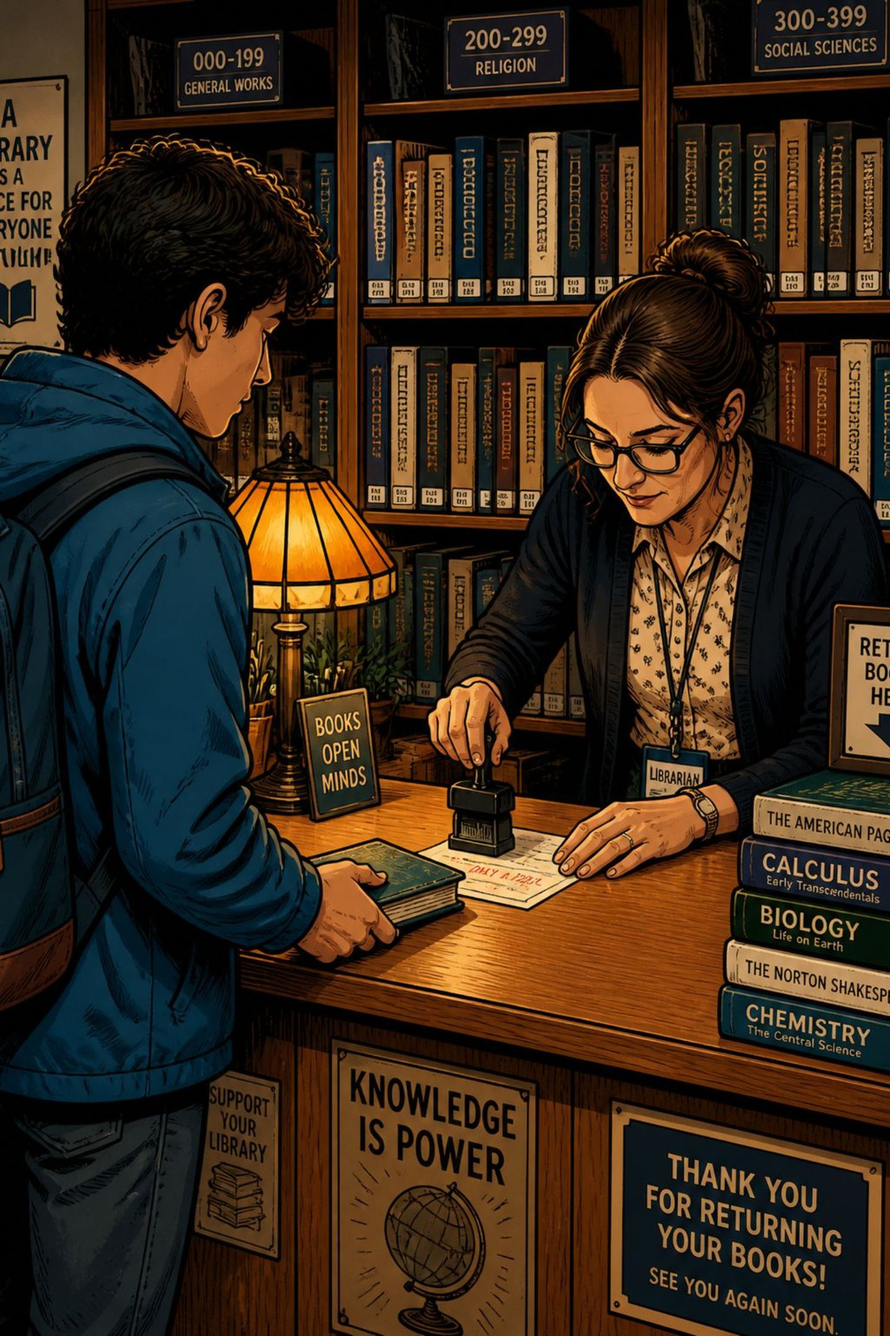

Borrowing Procedure — Step‑by‑Step
Clear steps ensure accountability and accurate circulation records. Follow each step before leaving the library with borrowed materials.
01
02
Locate & Inspect
Issue at Counter
Retrieve books from stacks and check pages for completeness. Report missing pages immediately.
Present membership card; staff will record checkout and stamp the due date on the slip.
03
Take Home for 14 Days
Standard loan period is 14 days unless otherwise specified; renewals subject to policy and demand.

Slide 20
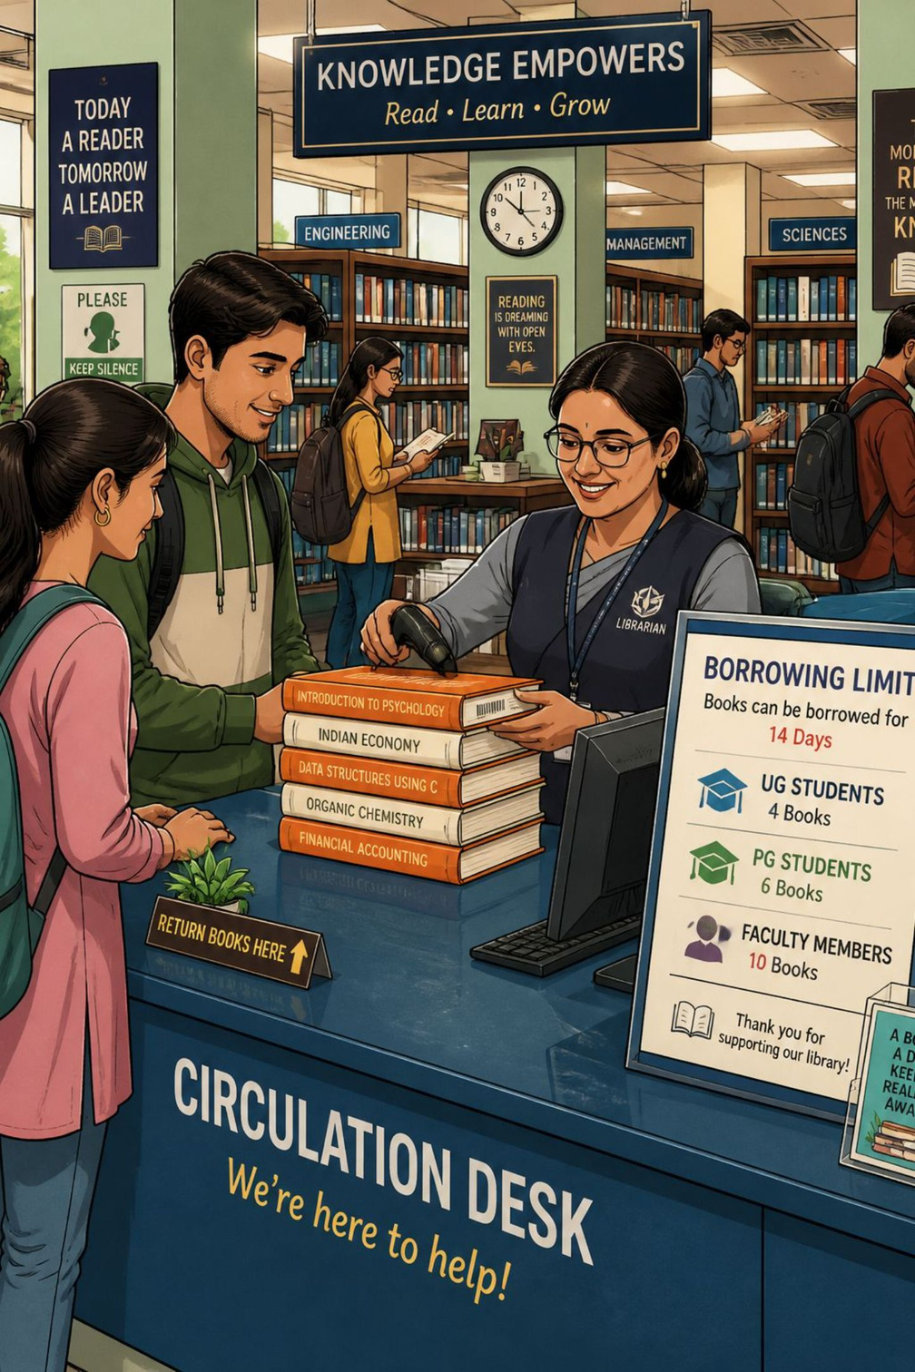
Book Lending Limits — Who Can Borrow What
Lending limits are set to balance access and responsibility across user groups. Loan periods and quantities differ by category.
Notes & Responsibilities
Undergraduate
  Inspect books before borrowing — undocumented damage may be charged
  Renewals depend on demand and reservation queues
  Late returns may incur fines per library policy
Up to 3 books for 14 days
Postgraduate
4–5 books for 14 days
Faculty
Contact circulation staff for exceptions, reserves, or course‑pack lending.
Up to 10 books for 1 month

Slide 21
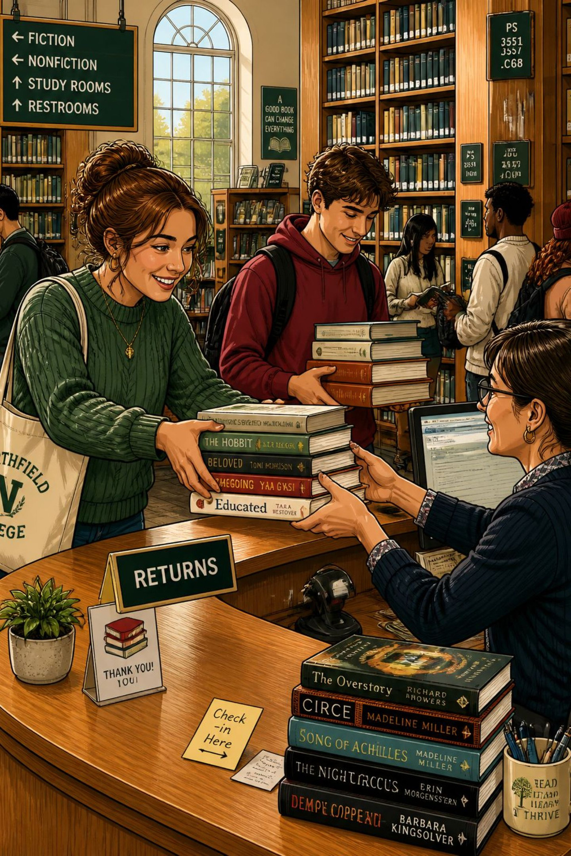
No Due Certificate — Library Clearance
Every student must obtain a No Due Clearance Certificate from the library before collecting their membership number or leaving college after returning library books. This certificate confirms all borrowed items are returned and outstanding obligations settled.
Who needs it?
When to get it
All students at semester end, on graduation, or at exit from college.
After returning all books and paying any fines — request the certificate from the library counter.
Why it matters
Serves as official proof that the student has no outstanding library dues; required for final clearance.

Slide 22
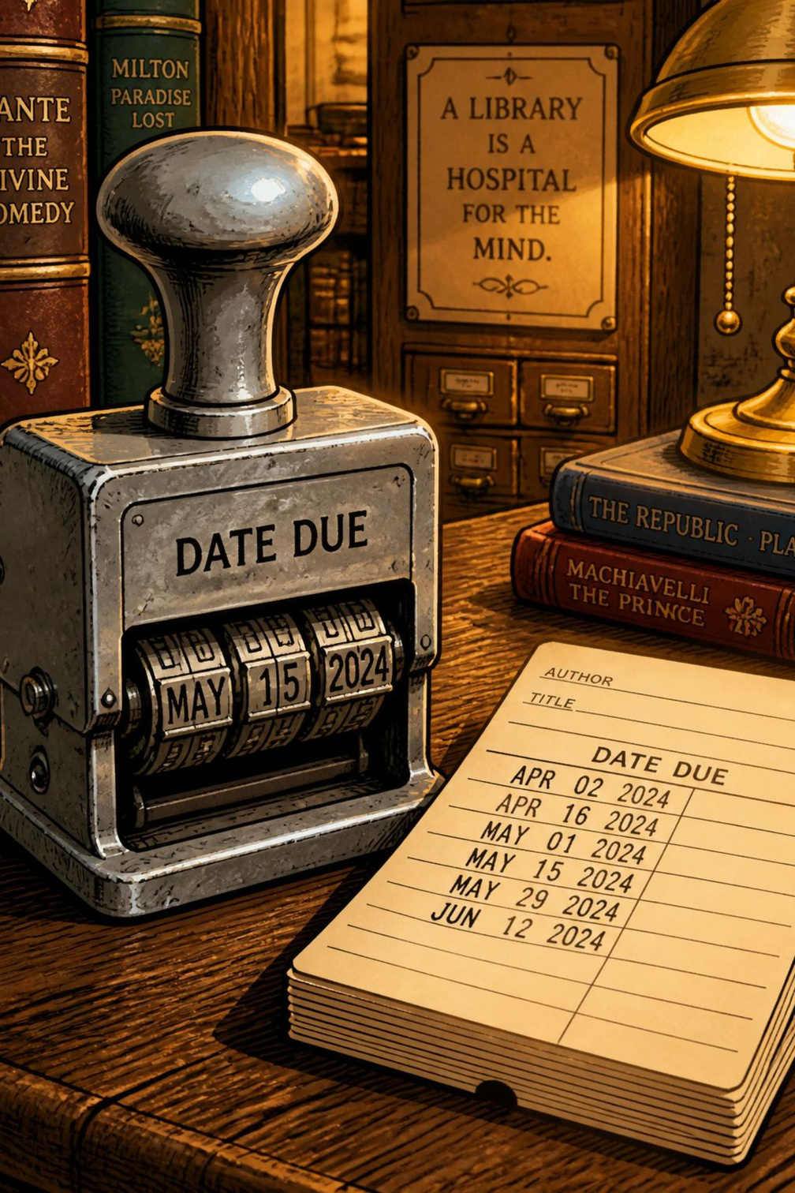
Library Fine Policy
Timely return of borrowed books is mandatory. Fines apply for late or lost items; settlement is required before issuing the No Due Certificate.
Late returns
Lost or damaged books
Rs. 1 per book per day will be charged for overdue items. Accrued fines must be cleared at the college office or library counter.
If a book is lost, the student must pay 50% extra on top of the book’s current price (i.e., 1.5 × replacement cost). Documentation of payment will be recorded before clearance.
Clear fines promptly to avoid delays in graduation or membership processing.

Slide 23
Classification Scheme — Main Classes
The library organises collections into ten principal classes to help users locate materials quickly. The headings below are the primary categories used across the stacks.
1000
100
200
Computer Science
Philosophy & Psychology
Religion
300
400
500
Social Science
Language
Science
600
700
800
Technology
Arts & Recreation
Literature
900
History

Slide 24
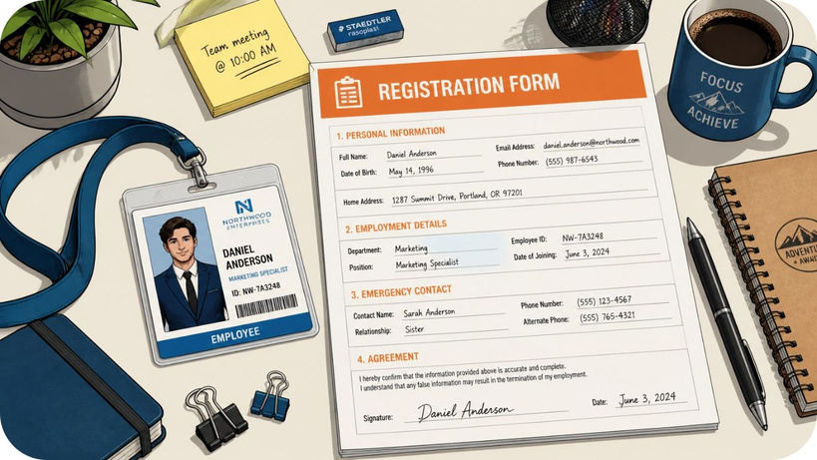
NDLI Club Membership — How to Join
The college subscribes to the National Digital Library of India (NDLI). Membership for the NDLI Club is managed by the College Librarian who uploads and activates user accounts.
Required user details
  Full name
  Valid e-mail ID
  Department
  Designation / Year
  Contact number
Provide accurate e-mail and phone number — an activation e-mail will be sent and must be used to complete account setup and access NDLI resources.

Slide 25




Library Advisory Committee — Structure
The Library Advisory Committee (LAC) offers a formal forum to discuss library policies, strategy and development. Members represent academic and administrative stakeholders.
Chairman
Convener
Library Faculty Coordinator
Members (HODs)
Principal — provides strategic oversight and final approvals.
Librarian — coordinates meetings, policy drafting and implementation.
Faculty member — represents academic library needs and curriculum integration.
HOD of Management and HOD of Commerce — provide departmental perspectives and user requirements.

Slide 26
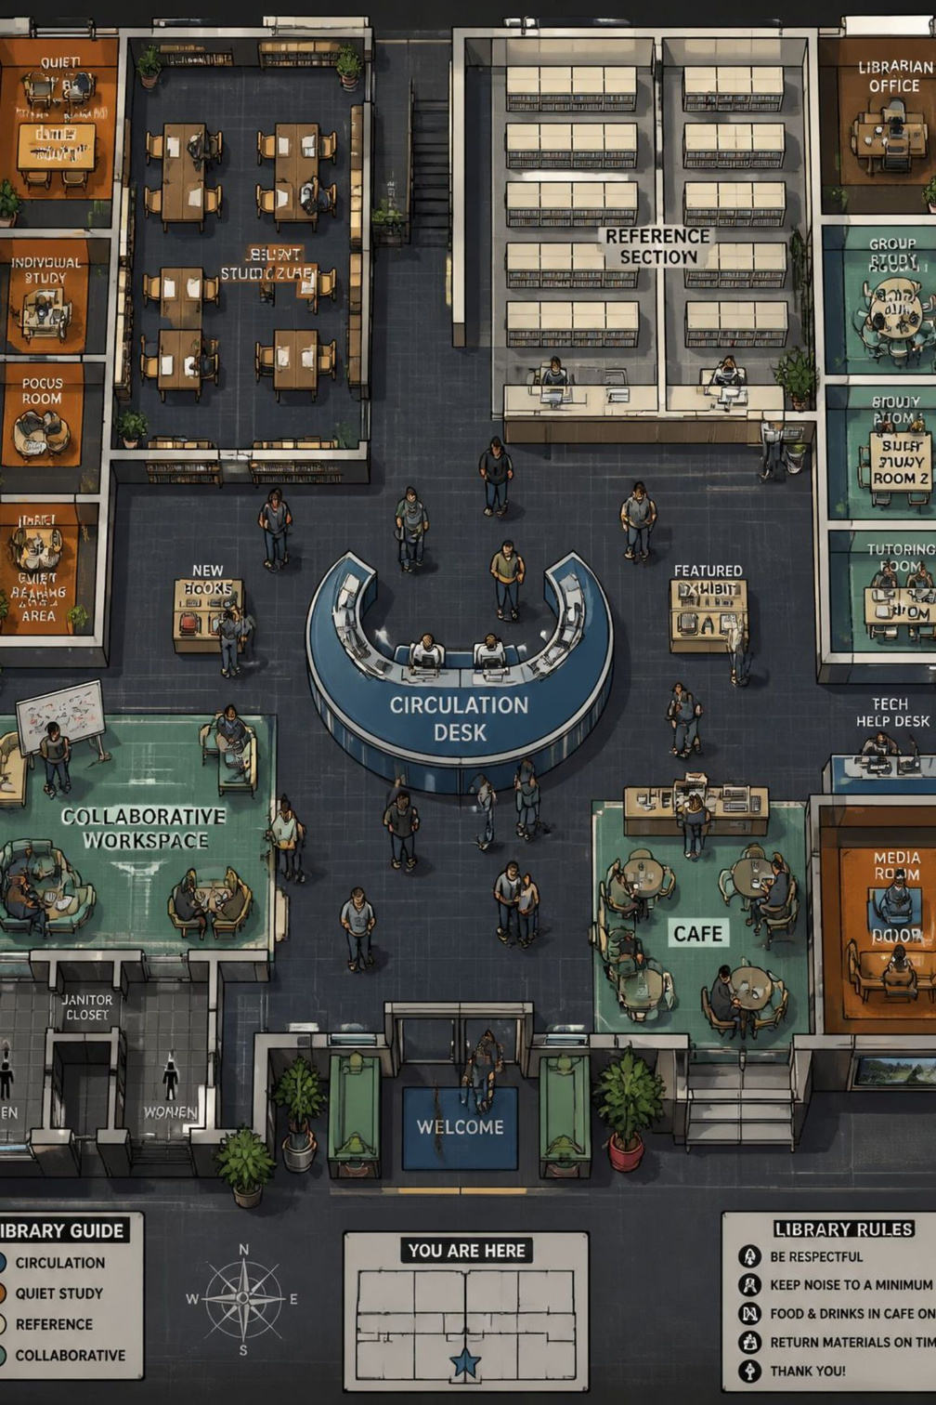
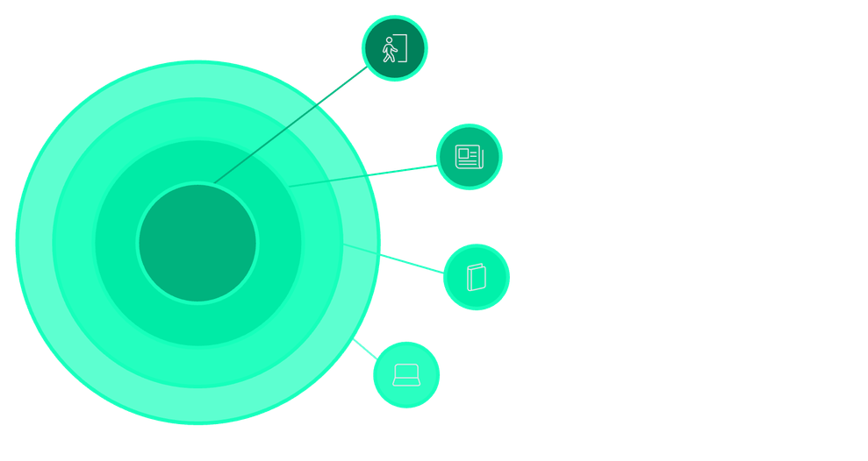
Library Layout — User Guide
The library is zoned for efficient navigation: entrance & circulation, reference & periodicals, stacks by classification, digital resources area, group study rooms, and staff/service zones. Clear signage matches the 000–900 classification to simplify locating materials.
Entrance & Circulation
Main access, signage and flow.
Reference & Periodicals
Current issues and help desk.
Stacks 000–900
Books organised by Dewey classes.
Digital & Study Zones
Computers, group and quiet study.
Note: Follow signage and ask the librarian for assistance with search systems, inter-library loans, or NDLI access.

